Slide 1

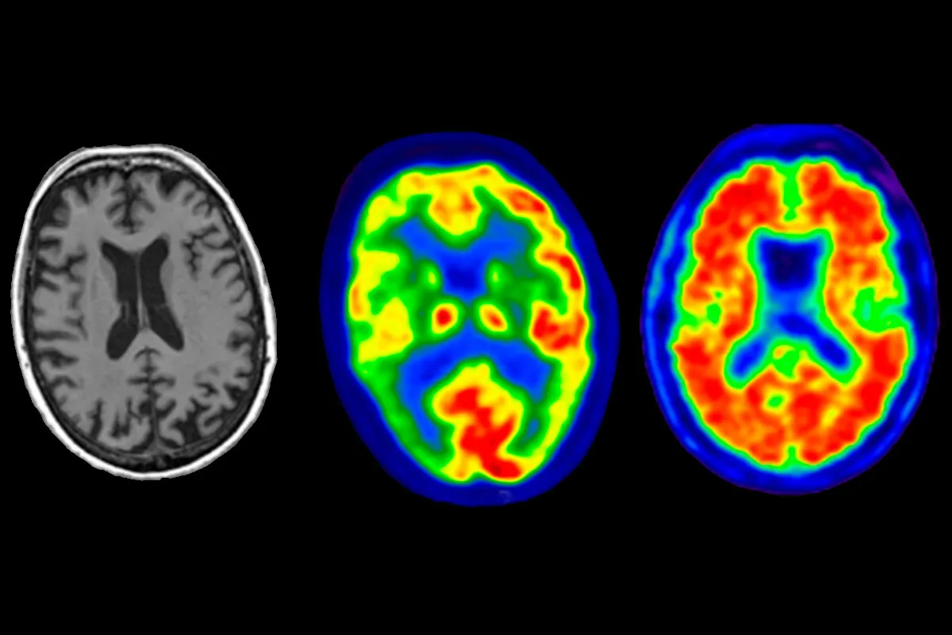
Nuclear Physics Applications in Medicine
Physics Foundations & Technological Challenges
Realized by :
Supervised by: Prof. Hicham Atmani
Ibtissam Ait Haddou
Khawla NAJMI
Marime Charafi
Korotimi Syla Sangare
School of applied and engineering physics.
May 11, 2026
Université Mohammed VI Polytechnique
School of applied and engineering physics.

Slide 2
Outline :
Introduction
Nuclear Imaging
Nuclear Therapy
Current Challenges
1
2
3
4
Nuclear Physics Applications in Medecine
11/05/2026

Slide 3
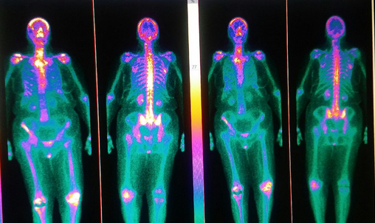
1) INTRODUCTION TO NUCLEAR MEDICINE :
Nuclear medicine uses radioactive isotopes for:
Medical Imaging
Therapy (cancer treatment)
In conventional X-rays:
The machine emits radiation
In nuclear medicine:
The patient becomes the source of radiation
Applications:
Cancer detection
Thyroid disorders
Bone imaging
Cardiac imaging
Functional imaging
Introduction
11/05/2026

Slide 4
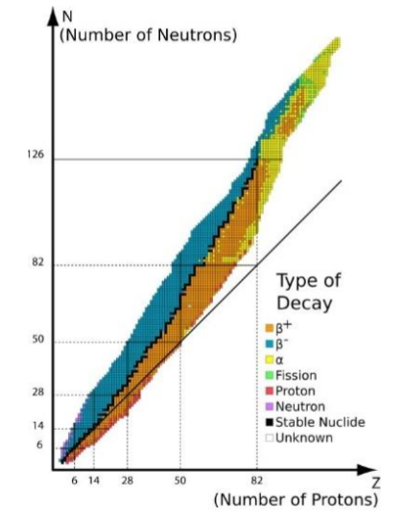
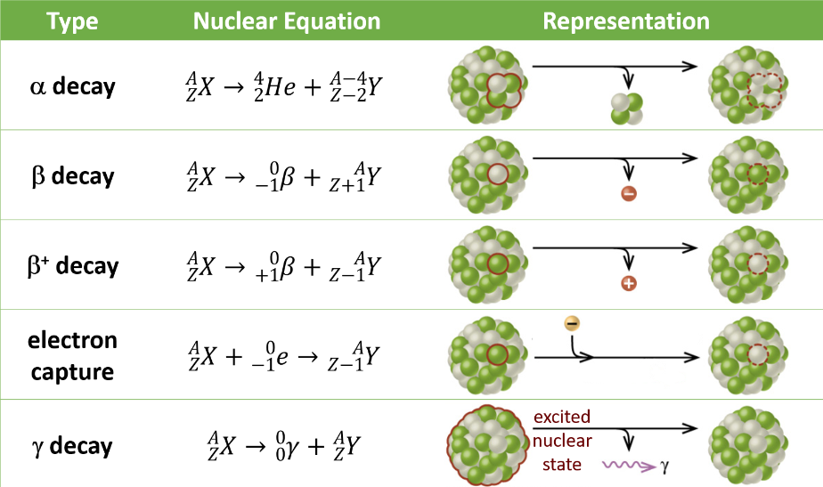
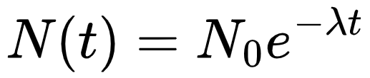
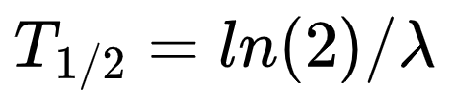
A) Radioactivity and Type of nuclear decay:
Radioactivity : The spontaneous transformation
of an unstable nucleus intro a more stable nucleus
Physics Foundations
11/05/2026

Slide 5
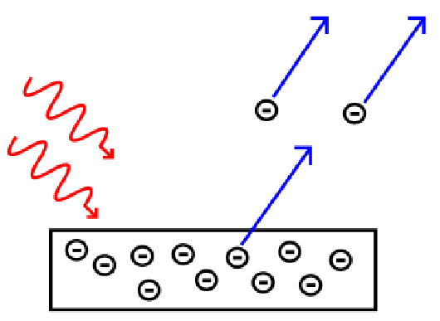
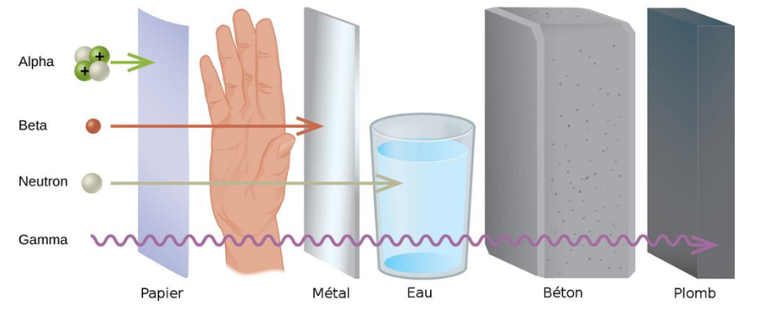
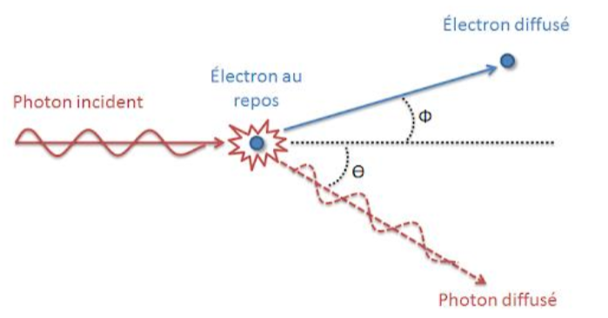
B) Interaction of radiation with bioligical matter:
Radiation interacts with tissues mainly through:
Ionization
Excitation of atoms
Main photon interactions:
Photoelectric effect
Alpha particles | Beta particles | Gamma rays
very high ionization very short range | moderate penetration scattering in tissues | highly penetrating detected outside the body
Compton scattering
Physics Foundations
11/05/2026

Slide 6
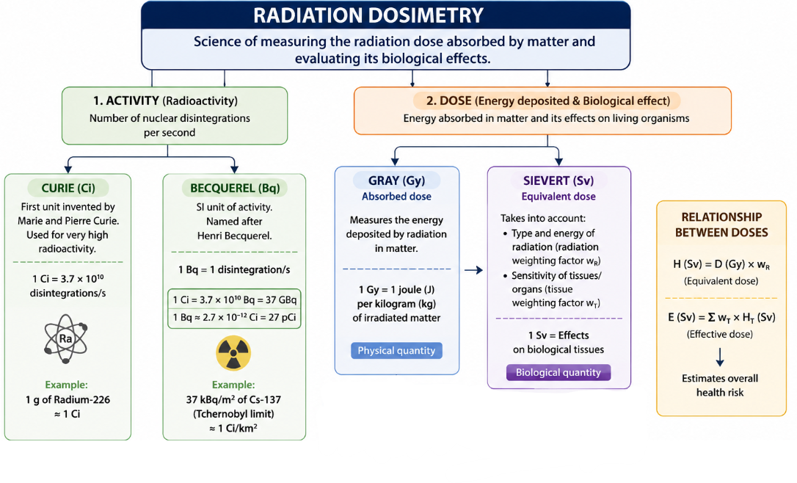
C) Radiation dosimetry :
Physics Foundations
11/05/2026

Slide 7
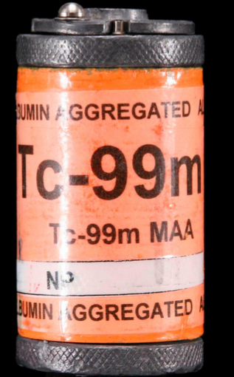
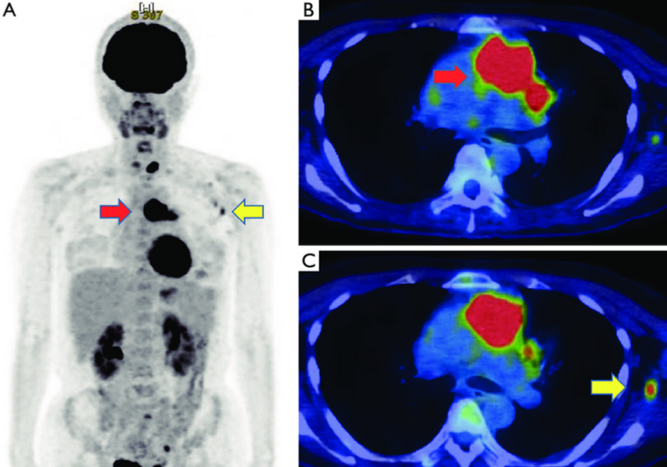
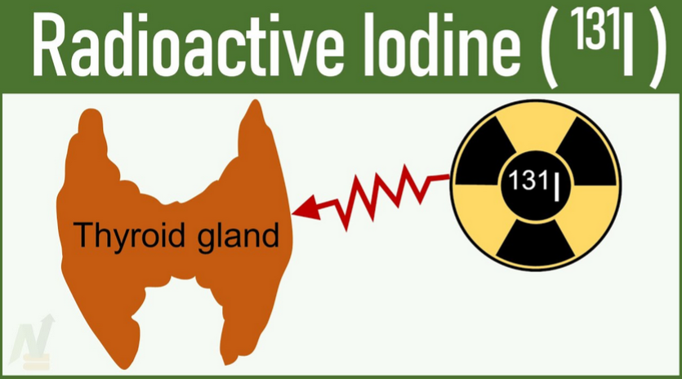
D) Criteria for choosing medical radioisotopes:
Half life | Type of radiation | Photon energy | Biological targeting
Short enough to reduce patient dose Long enough for examination or therapy | γ emitters for imaging β or α emitters for therapy | Typically 100–200 keV for imaging | Must accumulate in target organ
Tc-99m F-18 PET scan I-131 (for thyroid therapy)
(imaging)
Physics Foundations
11/05/2026

Slide 8
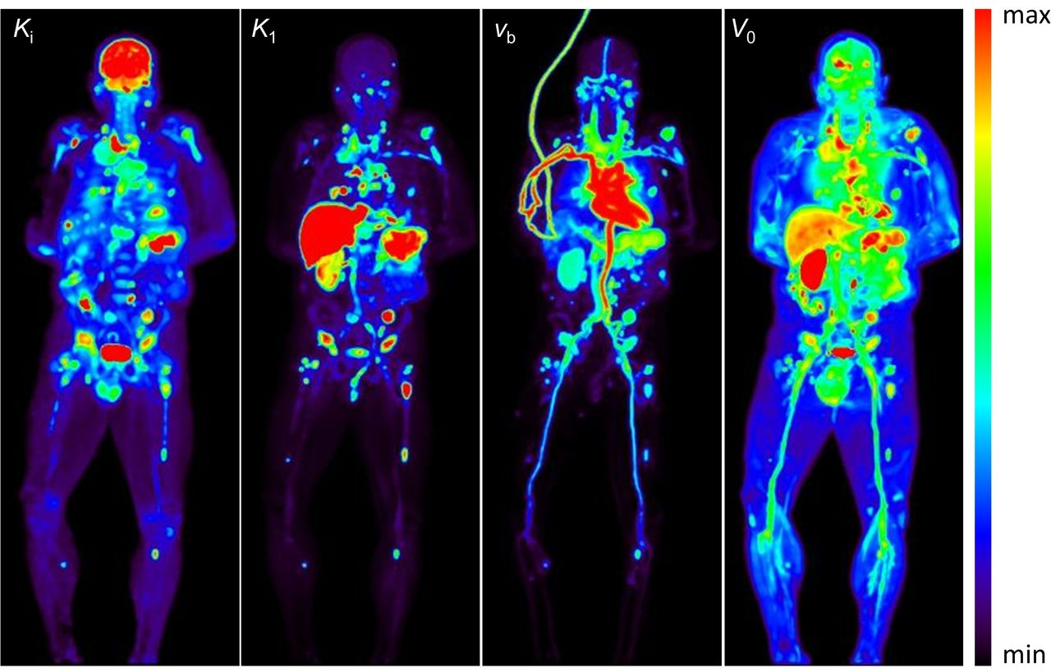
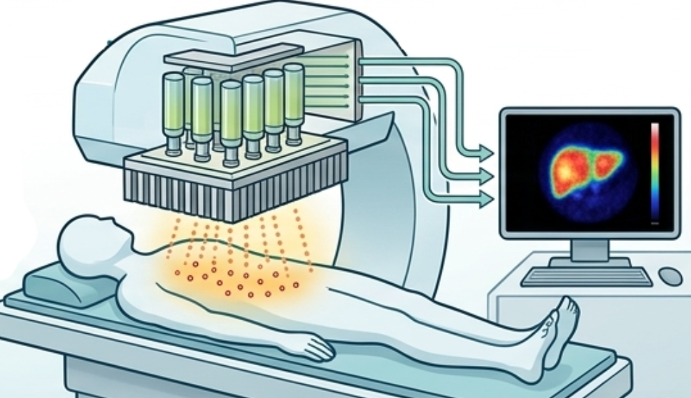
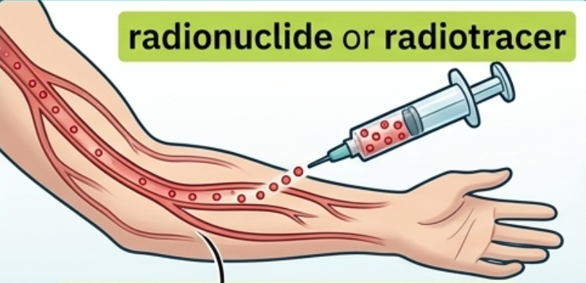
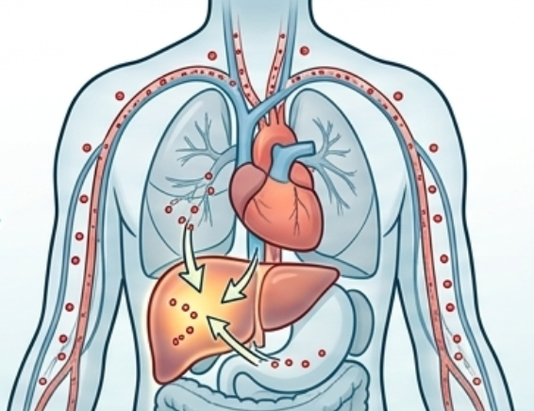
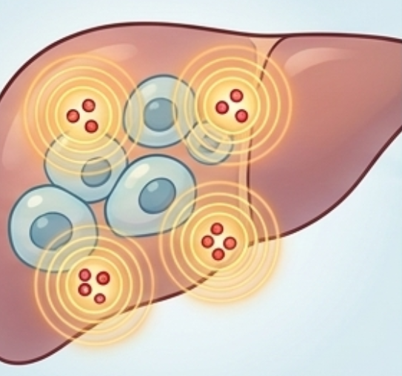
2) Nuclear Imaging
Nuclear imaging sees function :
Is the tumor metabolically active?
Is the organ working properly?
Where has cancer spread?
Other techniques see structure :
X-ray / CT → shape & bones
MRI → soft tissue detail
Nuclear Imaging techniques :
Planar Scintigraphy
SPECT (Single Photon Emission Computed Tomography)
PET (Positron Emission Tomography)
Figure 1
The Principles of Nuclear Imaging :
Injection of the Radiotracer
External Detection and Image Formation
Distribution in the Body
Radioactive Emission
Nuclear Imaging
11/05/2026

Slide 9
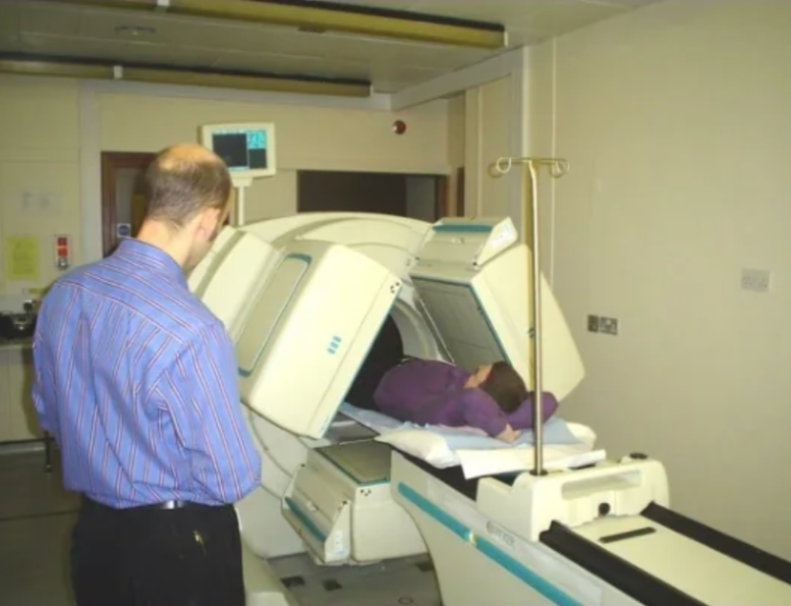
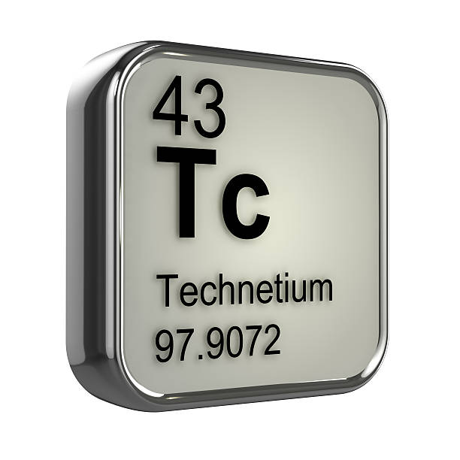
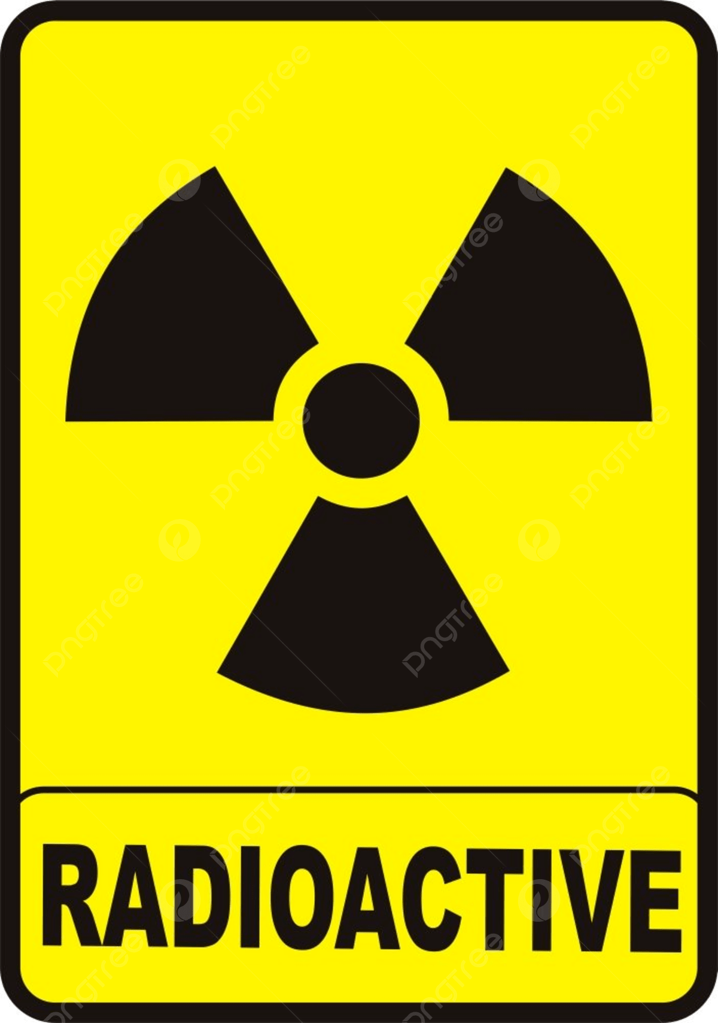
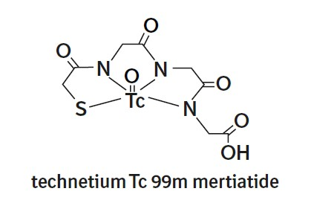
A) Planar Scintigraphy
Scintigraphy :
Latin scintilla meaning spark
Oldest and simplest
flat, 2D image
a) The Radiotracer:
Radiotracer = Carrier molecule + Radioactive atom
Carrier : sugar, hormone, antibody
Targets a specific organ
The radioactive atom (called a radionuclide or radioisotope) is attached to the carrier. Its job is to emit gamma rays so the detector can find it.
property | Value
Type of emission | Gamma rays only (140 keV)
Half-life | 6 hours
Energy | 140 keV
Production | From a Mo-99/Tc-99m generator
Nuclear Imaging
11/05/2026

Slide 10
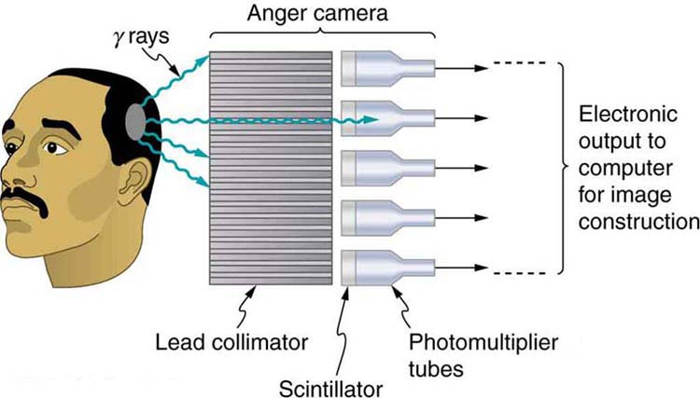
A) Planar Scintigraphy
b) The Gamma Camera (Anger Camera):
Radiotracer emits gamma rays in all directions. The gamma camera must:
Capture those gamma rays
Determine where each gamma ray came from
Build a 2D image from all those data points
Layer 1 :Collimator (lead)
Blocks 99.9% of γ rays
Only perpendicular rays pass
Defines image sharpness
Anger Logic (1958)
Each PMT gets different light intensity
Position calculated by weighted average X = Σ(Sᵢ · xᵢ) / ΣSᵢ
Millions of dots → 2D map
Layer 2: NaI(Tl) Crystal
γ ray → 1,000–3,000 light flashes
Scintillation principle
Limitations
2D only : no depth info
Attenuation : deep = weak signal
Layer 3: PMTs (37–91 tubes)
Light → electrical signal
Amplification ×1,000,000
Nuclear Imaging
11/05/2026

Slide 11
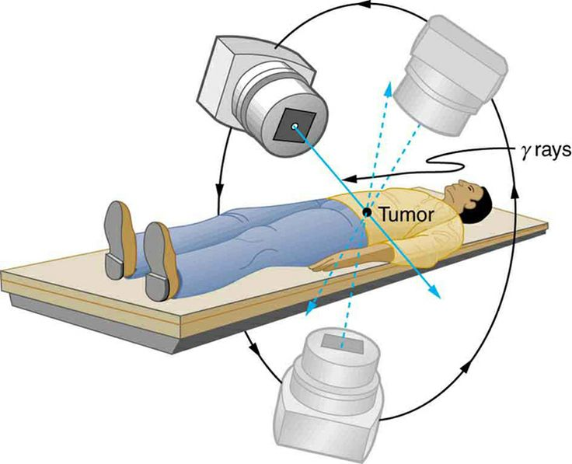
B) SPECT (Single Photon Emission Computed Tomography)
SPECT takes scintigraphy and adds 3D reconstruction.
SPECT = Scintigraphy + Rotation + Math
How SPECT Works ?
Step 1: Rotating the Camera
Step 2 : Reconstruction (algorithms )
Camera rotates 360° around patient
Takes 60–120 projections at every angle
FBP : Filtered Back Projection
Projects shadows back from all angles → overlap = object location
Fast but noise-sensitive → streak artifacts
OSEM : Ordered Subset Expectation Maximization
Starts with a guess → compares → refines repeatedly
Slower but cleaner & more accurate → modern standard
SPECT Limitations
Spatial resolution still limited (~8 to 12 mm)
Scan time is long (15 to 45 minutes of rotation)
Sensitivity lower than PET (fewer gamma rays are detected)
Only one gamma ray per decay is detected
Nuclear Imaging
11/05/2026

Slide 12
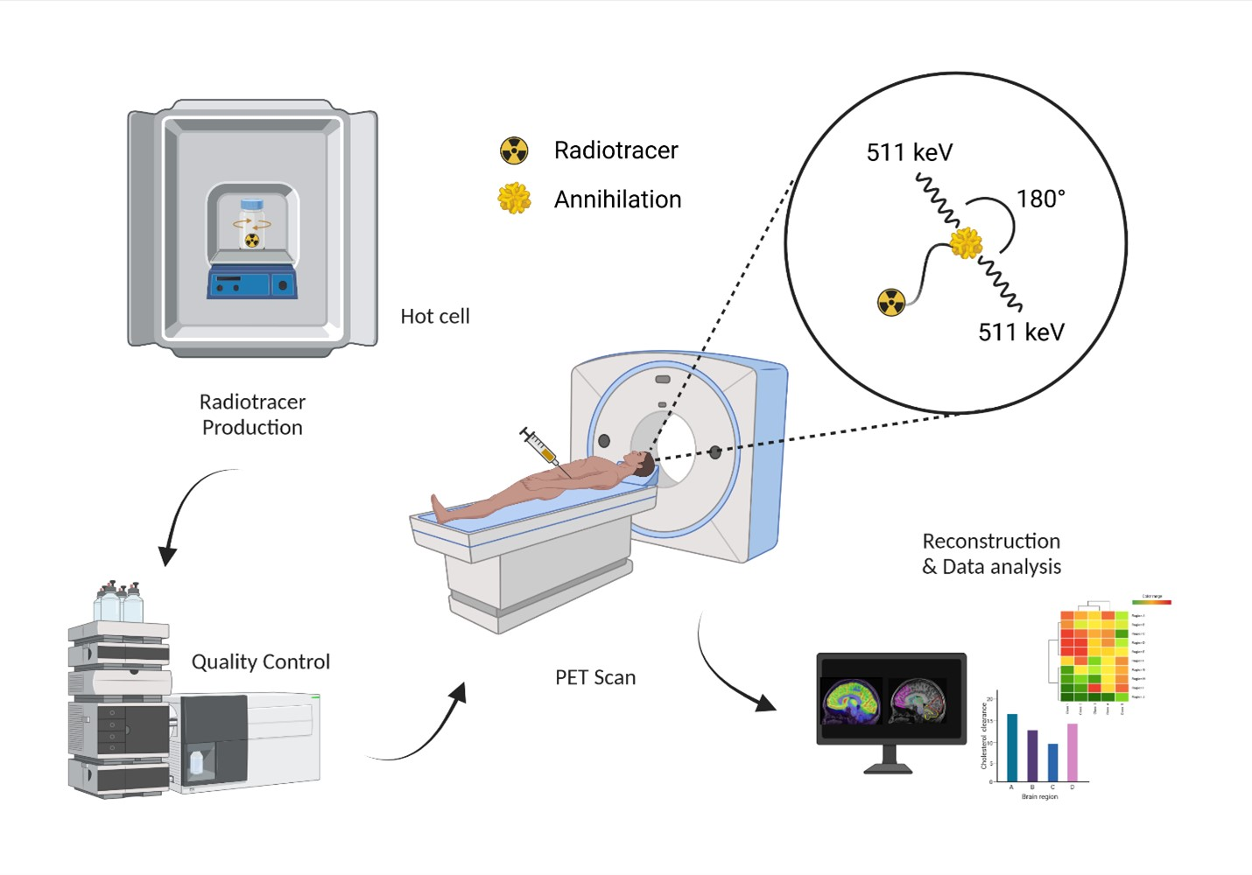
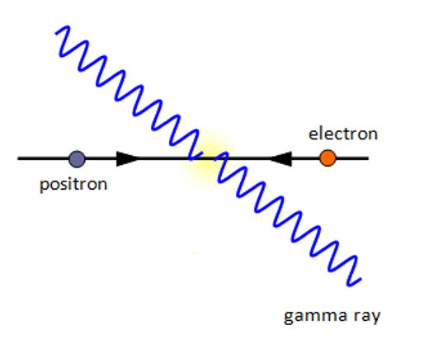
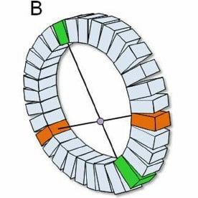
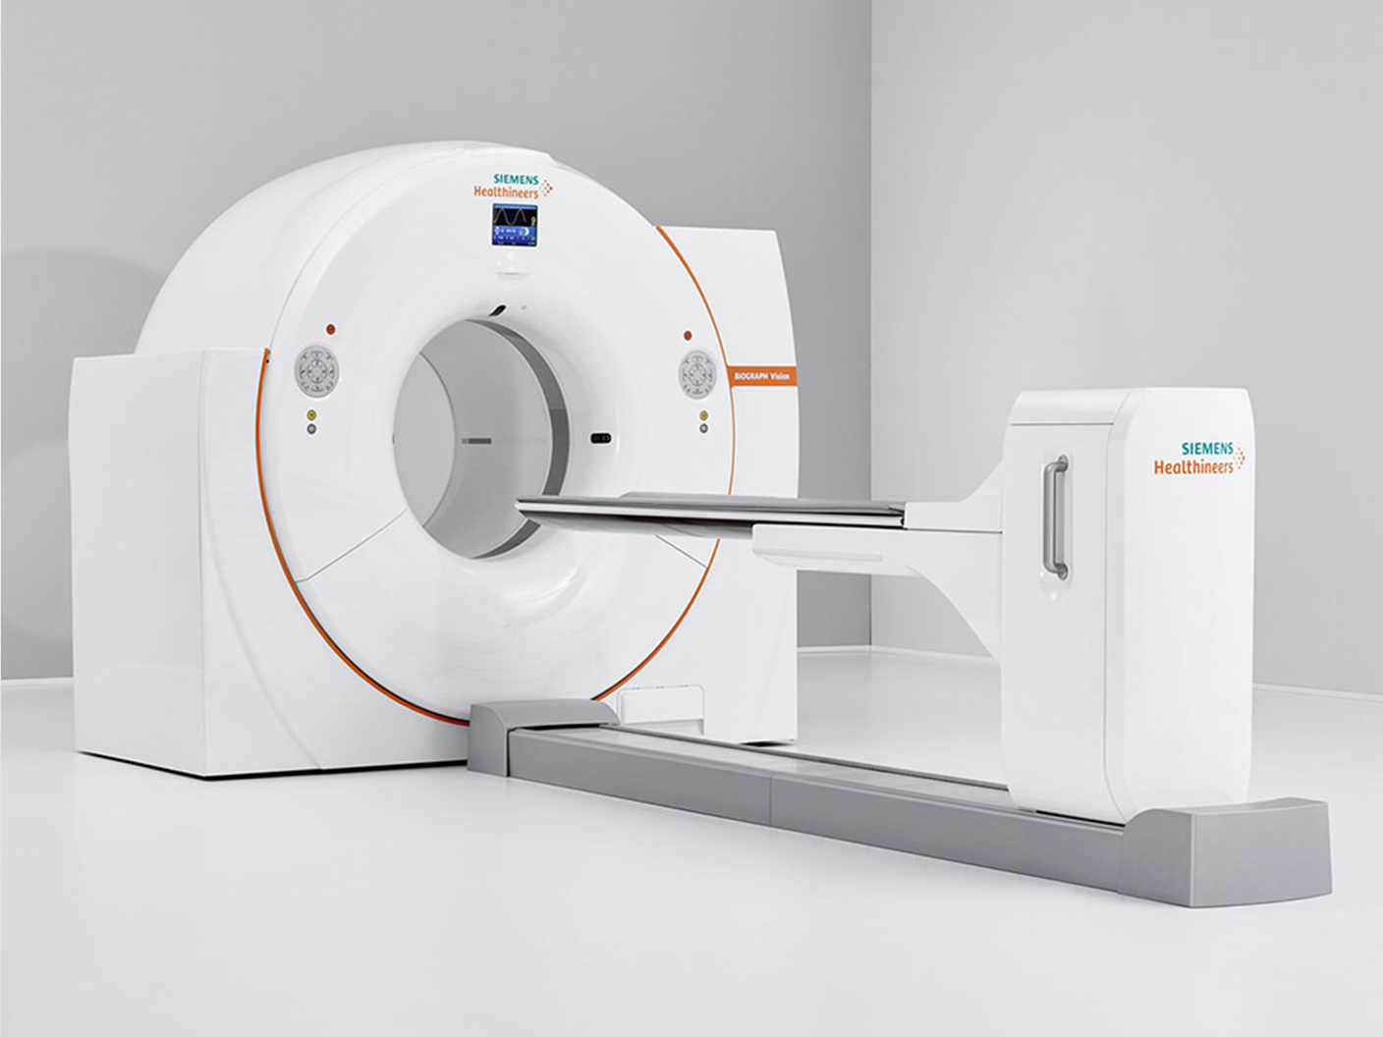
C) PET (Positron Emission Tomography)
PET is the most sensitive and highest resolution form of nuclear imaging
a) Positron Annihilation :
1) Positron emission
¹⁸F → ¹⁸O + β⁺ + νₑ
2) Annihilation
β⁺ + e⁻ → γ (511 keV) + γ (511 keV)
b) The PET Detector Ring , Coincidence Detection
If detector A and detector B both register a 511 keV gamma ray within ~5–10 nanoseconds of each other
the system concludes: an annihilation occurred somewhere along the line connecting A and B (called a "line of response" or LOR)This is recorded as one valid event
By recording millions of LORs from all directions around the ring
the computer can use the same tomographic reconstruction algorithms (OSEM) as SPECT to build a 3D image
Figure 1 : A PET scanner is a ring of thousands of small detector crystals
A
Nuclear Imaging
11/05/2026

Slide 13
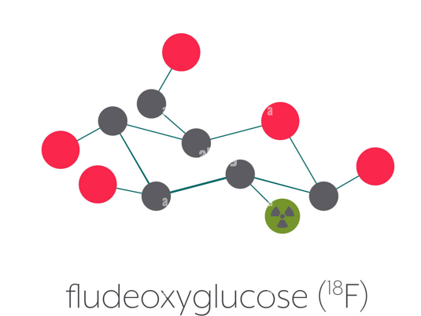
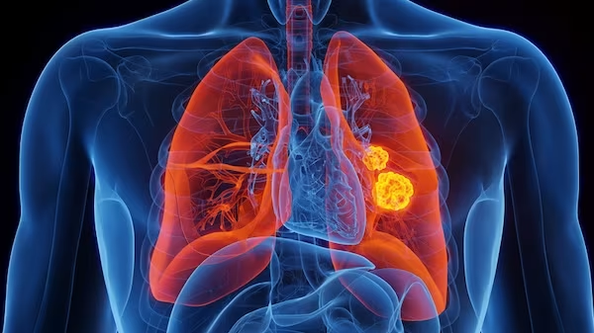



C) PET (Positron Emission Tomography)
c) The Key Radiotracer : ¹⁸F-FDG (fluorodeoxyglucose)
Why it works for cancer
Warburg effect : tumors consume 5 to 10× more glucose
The most widely used PET radiotracer in the world
¹⁸F : Fluorine-18 | FDG : Modified Glucose
Positron emitter (β⁺) | Identical to real glucose
Half-life : 110 min | Enters cells → gets trapped
Produced by cyclotron | Cannot leave → accumulates
d ) SUV (Standardized Uptake Value)
SUV$=\frac{radioactive concentration }{injected /body weight }$
Clinical uses
Cancer staging & recurrence
Chemotherapy monitoring
Brain : Alzheimer's, epilepsy
For exemple : SUV > 2.5 in a lung nodule is suspicious for malignancy.
Nuclear Imaging
11/05/2026

Slide 14
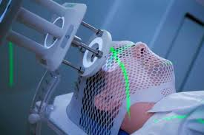
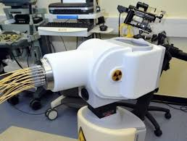
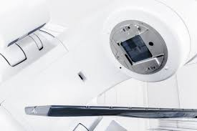
3) THERAPEUTIC APPLICATIONS :
how do we use radiation to destroy cancer cells while protecting healthy tissue as much as possible?
External Beam Radiotherapy (EBRT)
Brachytherapy
Targeted Radionuclide Therapy (TRT)
maximize dose to the tumor, minimize dose to healthy tissue.
Nuclear Therapy
11/05/2026

Slide 15
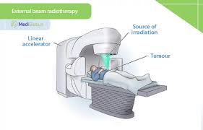
B) External beam radiotherapy
Principle
A machine outside the patient generates a beam of radiation and points it at the tumor. The beam enters the body, crosses healthy tissue, hits the tumor, and depending on the type of radiation may or may not exit on the other side.
Nuclear Imaging
11/05/2026

Slide 16
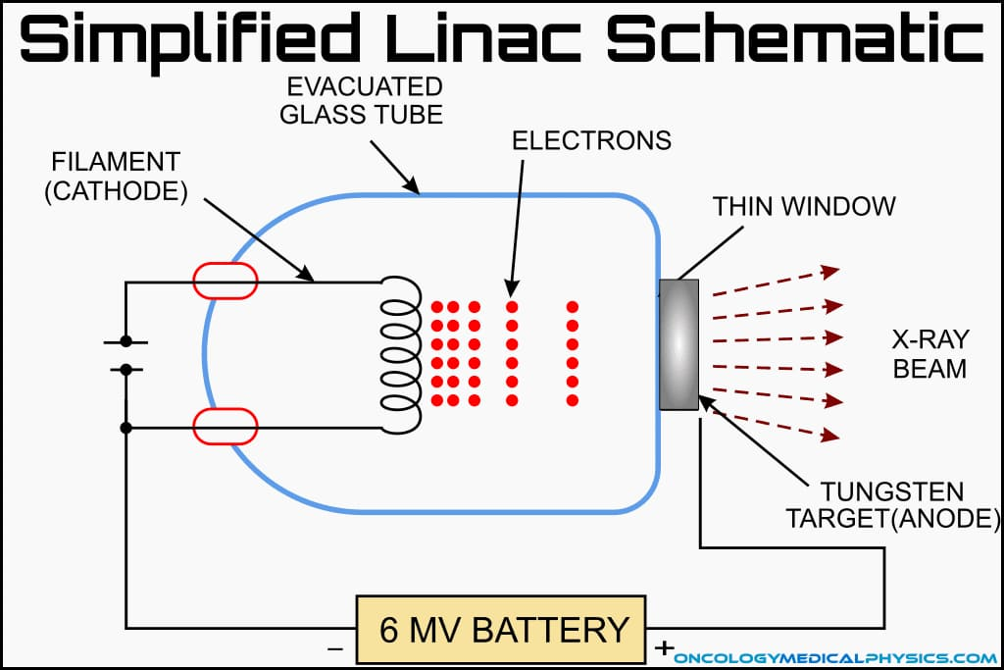
B) External beam radiotherapy
1. Photon Therapy (X-rays)
The most common machine is called a LINAC (Linear Accelerator). It accelerates electrons to very high energies (6–18 MeV), then slams them into a tungsten target. The electrons suddenly decelerate and produce X-rays this process is called bremsstrahlung
The X-ray beam enters the patient's body and deposits its energy mainly through three interactions with tissue:
Interaction | Energy range | What happens
Photoelectric effect | < 0.1 MeV | Photon absorbed completely, ejects electron
Compton scattering | 0.1–10 MeV (dominant in therapy) | Photon scatters off electron, both continue
Pair production | > 1.022 MeV | Photon creates electron + positron pair
Nuclear Imaging
11/05/2026

Slide 17
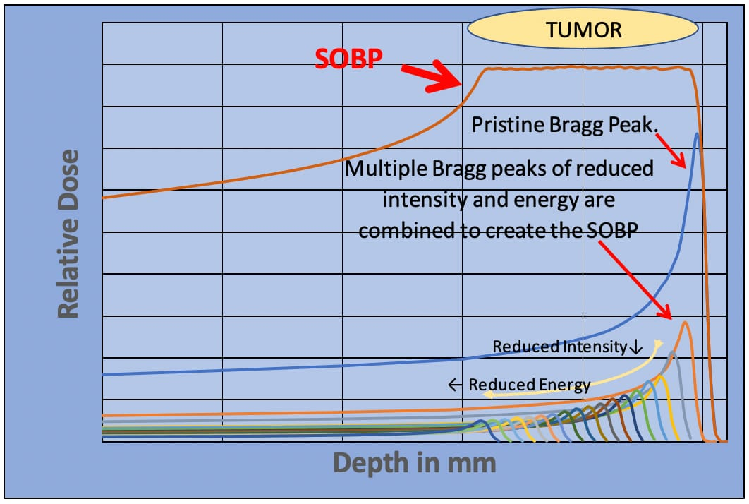
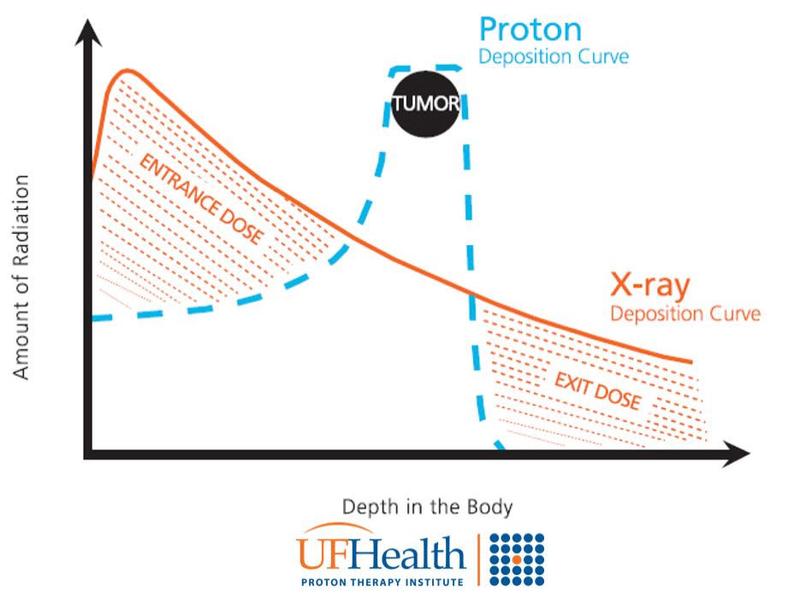
A) External beam radiotherapy
2 Electron Therapy
Electrons (β⁻ particles) have a short range in tissue a few centimeters because they lose energy quickly by ionizing atoms along their path.This makes them ideal for superficial tumors: skin cancer, chest wall lesions, post-mastectomy treatment. Below about 5–6 cm depth, the dose drops to nearly zero.
3.Hadrontherapy
Proton therapy dose diagram
Proton vs X-ray dose curves
Nuclear Imaging
11/05/2026

Slide 18
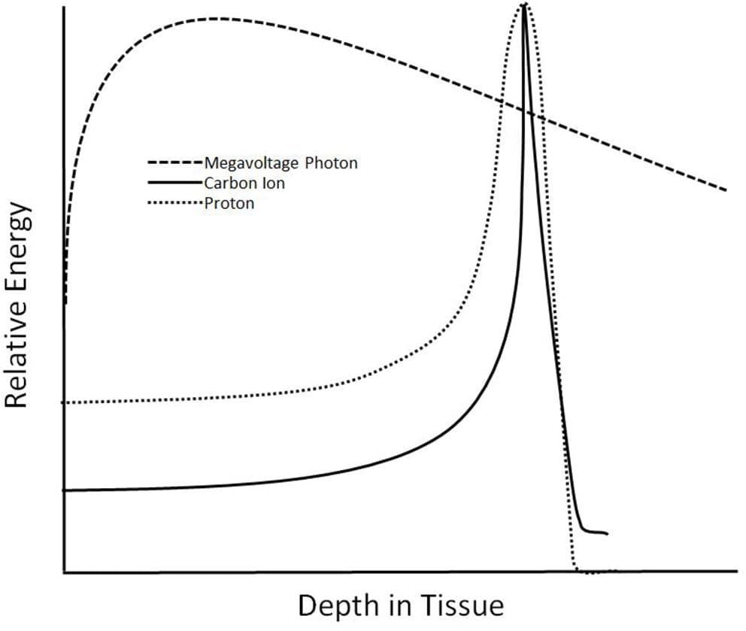

A) External beam radiotherapy
Carbon Ions vs. Protons ,Relative Biological Effectiveness (RBE)
Carbon ions (C-12, charge z = 6) lose energy 36 times faster than protons (z² ratio: 6² vs 1²) for the same velocity. This creates a much sharper, more intense Bragg peak.
Linear Energy Transfer (LET):
LET=−dE/dx ​
the Bethe-Bloch equation:
RBE (Relative Biological Effectiveness):
$$\text{R}\text{B}E =\frac{\text{Dose} \text{of} \text{reference} \text{radiation}\text{ (}\text{X}\text{−}\text{rays}\text{) }\text{to} \text{achieve} \text{same} \text{effect}\text{​ }}{\text{Dose} \text{of} \text{a} \text{test} \text{radiation} \text{to} \text{produce} \text{the} \text{same} \text{biological} \text{effect}}$$
Nuclear Imaging
11/05/2026

Slide 19
A) External beam radiotherapy
Feature | Photons (X-rays) | Protons | Carbon ions (C-12)
Bragg peak | No | Yes | Yes, sharper
Exit dose | Yes | Nearly zero | Nearly zero
LET (at tumor) | ~0.5 keV/µm | ~10 keV/µm | ~80 keV/µm
RBE | 1 (reference) | ~1.1 | ~2–3
Best for | Most tumors | Skull base, pediatric | Radioresistant tumors
Clinical centers (2024) | Everywhere | ~120 worldwide | ~15 worldwide
Nuclear Imaging
11/05/2026

Slide 20
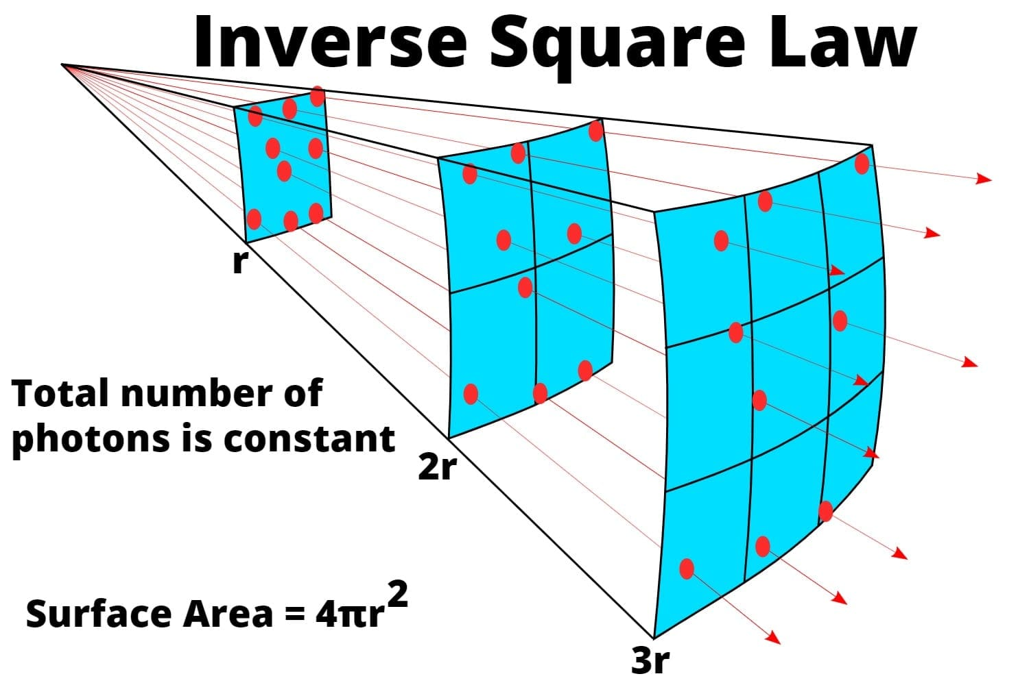

B) Brachytherapy
Principle
internal radiation therapy where sealed radioactive sources are placed directly into or adjacent to a tumor, providing highly localized, high-dose treatment.
INVERSE-SQUARE LAW
Brachytherapy uses sealed sources
Isotope | Half-life | Energy | Main clinical use
¹⁹²Ir (Iridium-192) | 73.8 days | 380 keV (γ) | HDR: cervix, breast, head & neck
¹²⁵I (Iodine-125) | 59.4 days | 28 keV (γ) | LDR: prostate permanent implant
¹⁰³Pd (Palladium-103) | 17 days | 21 keV (γ) | LDR: prostate (low-grade)
⁶⁰Co (Cobalt-60) | 5.27 years | 1.25 MeV (γ) | HDR alternative to Ir-192
Doubling the distance from the source divides the dose by ~4 , neighboring tissues are spared a few millimeters away.
Nuclear Imaging
11/05/2026

Slide 21
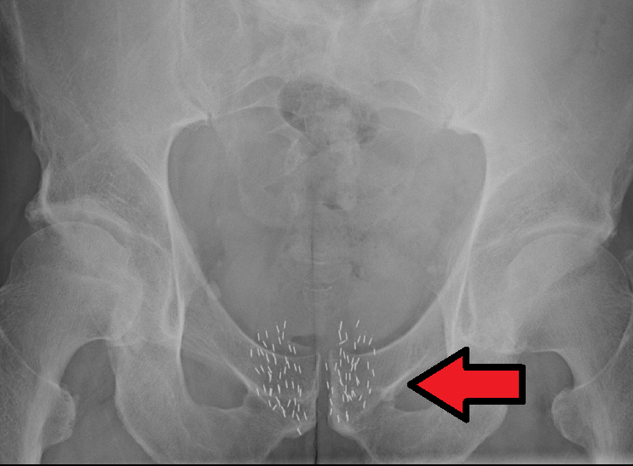
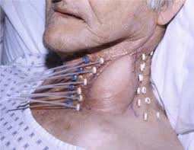
B) Brachytherapy
Brachytherapy is therefore classified by dose rate:
Clinical Applications:
Category | Dose rate | How it works
LDR (Low Dose Rate) | 0.4–2 Gy/h | Seeds implanted permanently; slow continuous irradiation over weeks
HDR (High Dose Rate) | > 12 Gy/h | Source inserted temporarily for minutes; patient goes home same day
PDR (Pulsed Dose Rate) | Pulses of ~0.5 Gy/h | Hourly pulses simulating LDR biology with HDR equipment
Prostate cancer
neck cancers
Nuclear Imaging
11/05/2026

Slide 22
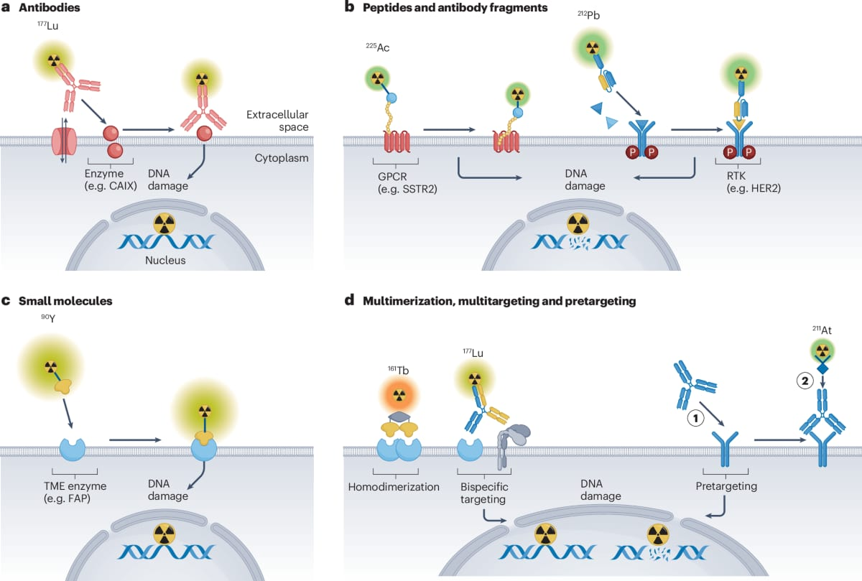
C) Targeted radionuclide therapy
Principle
TRT is a systemic treatment that uses radiopharmaceuticals , radioactive atoms chemically coupled to biological carrier molecules to deliver ionizing radiation selectively to cancer cells.
Nuclear Therapy
11/05/2026

Slide 23
C) Targeted radionuclide therapy
Comparative Summary of the 3 TRT Agents
Property | ¹³¹I | ¹⁷⁷Lu | ²²³Ra
Particle type | β⁻ + γ | β⁻ + γ | α (+ β, γ chain)
Half-life | 8.05 days | 6.65 days | 11.4 days
Range in tissue | ~2.4 mm | ~1.5 mm | < 0.1 mm
LET | Low (~0.5 keV/µm) | Low–medium | High (~80 keV/µm)
Targeting mechanism | NIS symporter | SSTR₂ receptor (NETs) / PSMA (prostate) | Calcium mimetic → hydroxyapatite
FDA approval | Decades | 2018 (Lutathera) / 2022 (Pluvicto) | 2013 (Xofigo)
Theranostic pair | ¹²³I (SPECT) | ⁶⁸Ga-DOTATATE (PET) | No direct pair
Nuclear Therapy
11/05/2026

Slide 24
4) CHALLENGES AND FUTURE PERSECTIVES:
Dose Optimization (ALARA, inverse planning)
Spatial Precision (IGRT, respiratory gating)
Radiation Protection (shielding, zoning, risks)
Dose Optimization
Main Challenge
•High dose → toxicity & healthy tissue damage
•Low dose → poor image quality or ineffective treatment
Key Concepts
•ALARA principle
(As Low As Reasonably Achievable)
•Inverse planning
Maximum dose to organs at risk (OAR)
Minimum dose to the tumor
•Optimization algorithms
→ balance between:
tumor coverage
healthy tissue protection
Goal​
Deliver the most effective dose while minimizing biological risks.​
​
Challenges & Perspectives
11/05/2026

Slide 25
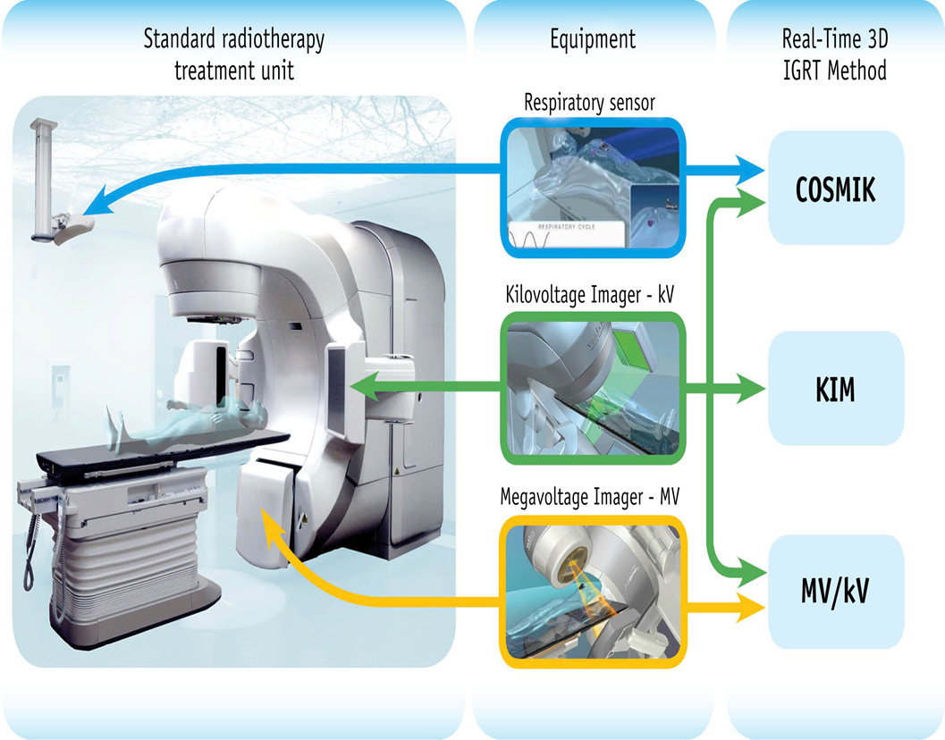
Spatial Precision
Main Challenges
•Patient motion
•Internal organ motion (breathing, organs)
Advanced Techniques
•IGRT (Image-Guided Radiotherapy)
→ real-time imaging for accurate positioning
•Respiratory gating
→ synchronization with the breathing cycle
•PTV safety margins
→ compensate for uncertainties and motion
Goal
Increase tumor targeting accuracy while protecting healthy tissues.
Challenges & Perspectives
11/05/2026

Slide 26
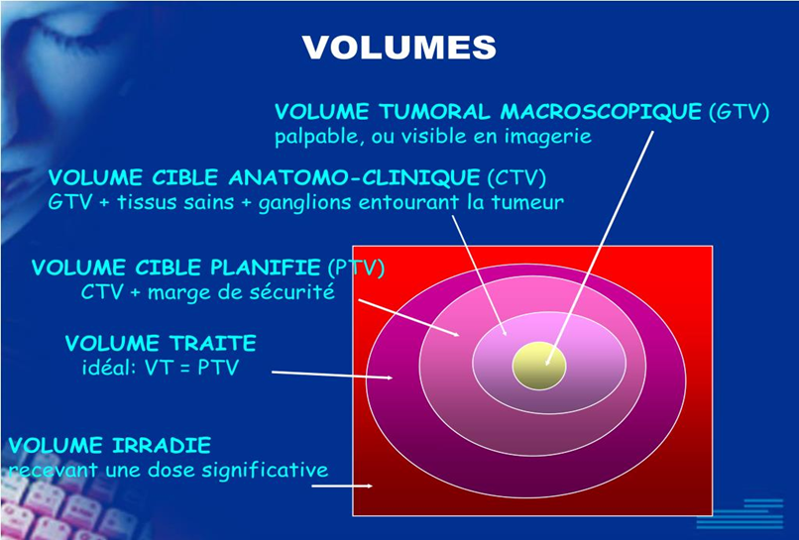
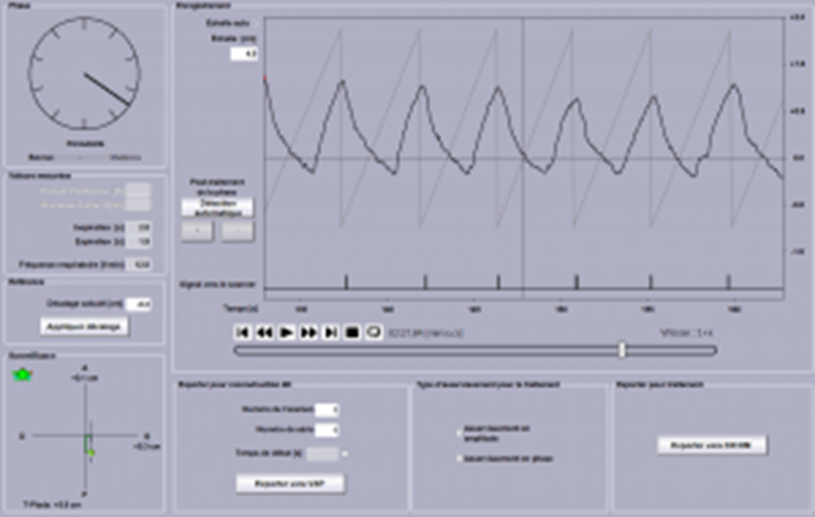
Spatial Precision
Respiratory gating
PTV safety margins
Challenges & Perspectives
11/05/2026

Slide 27
Radiation Protection
Main Objectives​
Protect patients ​
Protect medical staff ​
Reduce environmental impact ​
Fundamental Principles
Time → reduce exposure duration
Distance → stay away from the source
Shielding → lead, concrete barriers
Radiation Risks
Deterministic effects
(burns, tissue damage)
Stochastic effects
(cancer risk)
Goal​
Minimize radiation risks while maintaining medical effectiveness.
Challenges & Perspectives
11/05/2026

Slide 28
Future Perspectives
Theranostics
•Same molecule for diagnosis & therapy
•Tracer + therapeutic radionuclide
•Personalized medicine
Artificial Intelligence
•Automatic treatment optimization
•Improved image reconstruction
•Clinical decision support
Nanoparticles
Targeted delivery to tumor cells
Localized dose delivery
Reduced side effects
Future Goal​
Towards more precise and personalized nuclear medicine.​
Future Perspectives
11/05/2026

Slide 29
General Conclusion
•Nuclear physics plays a major role in modern medicine
•Applications in imaging and therapy improve diagnosis and treatment
•Major challenges:
•dose optimization
•spatial precision
•radiation protection
•Future perspectives:
•theranostics
•artificial intelligence
•personalized medicine
•Toward safer, smarter, and more precise healthcare
General Conclusion
11/05/2026

